Slide 1
Event Management System Developed in PHP & MySQL

Slide 2
Intorduction
Scope of the Project
The objective of this application is to develop a system that effectively manages all the data related to the various events that take place in an organization. The purpose is to maintain a centralized database of all event related information. The goal is to support various functions and processes necessary to manage the data efficiently.
Existing System
This existing system is not providing secure registration and profile management of all the users properly. This system is not providing on-line Help. This system doesn’t provide tracking of users activities and their progress. This manual system gives us very less security for saving data and some data may be lost due to mismanagement. This system is not providing event management through internet. This system is not providing proper events information. The system is giving manual information through the event management executer.

Slide 3
Proposed System
The development of this new system contains the following activities, which try to automate the entire process keeping in the view of database integration approach. This system maintains user’s personal, a and contact details. This system will provide on line help and search capabilities. User friendliness is provided in the application with various controls provided by system rich user interface. Authentication is provided for this application only registered users can access. Event information files can be stored in centralized database which can be maintained by the system. This system provides the users to manage the events systematically.

Slide 4
Project Modules
The system after careful analysis has been identified to be presented with the following modules:
In EMS project we use PHP and MySQL database. It has two modules.
Admin Module
User Module

Slide 5
Banker Module
Dashboard: In this section, admin can see all detail in brief like listed categories, Sponsors, Total Events, Total Registered Users, Total Booking, Total New Booking, Total Confirmed Booking and Total Cancelled Booking.
Category: In this section, admin manage event category (add and update).
Manage Sponsors: In this section, admin can add sponsors and manage sponsors details (Add/Update/Delete).
Events: In this section, admin manage events (add and update).
Manage Users: In this section, admin can update details of registered users and also block them.
Manage Booking: In this section, admin can manage booking by cancel and confirm it.
News: In this section admin manage news (add and delete).
Website Setting: In this section, admin can update about us and another general website setting.
Admin can also update his profile, change password and recover password.

Slide 6
User Module
In this module there is two types of user guest user and registered user.
Guest User: In this guest user can see only general information like about us, event details,
Contact details and new about events.
Registered users can do following activity
Books the events.
Update his/her own profile.
Change Password.
Users can also cancel booking which is not confirmed.
Registered user can also recover his/her own password.

Slide 7
Requirement Specification
Hardware Configuration:
Client Side
Server Side
RAM | 512 MB
Hard Disk | 10GB
Processor | 1.0 GHz
RAM | 1 GB
Hard Disk | 20GB
Processor | 2.0GHz

Slide 8
Continue.....
Software Requirement:
Client Side
Server Side
Web Browser | Google Chrome or any compatible browser
Operating System | Windows or any equivalent OS
Web Server | APACHE
Server side Language | PHP5.6 or above version
Database Server | MySQL
Web Browser | Google Chrome or any compatible browser
Operating System | Windows or any equivalent OS

Slide 9
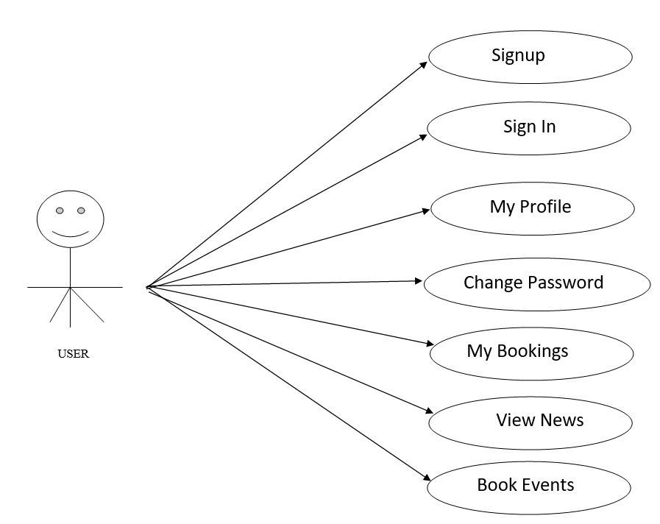
Use Case Diagram
User use case diagram
Notes:
USECASE DIAGRAM: A Use case is a description of set of sequence of actions. Graphically it is rendered as an ellipse with solid line including only its name. Use case diagram is a behavioral diagram that shows a set of use cases and actors and their relationship. It is an association between the use cases and actors. An actor represents a real-world object. Primary Actor – Sender, Secondary Actor Receiver.

Slide 10
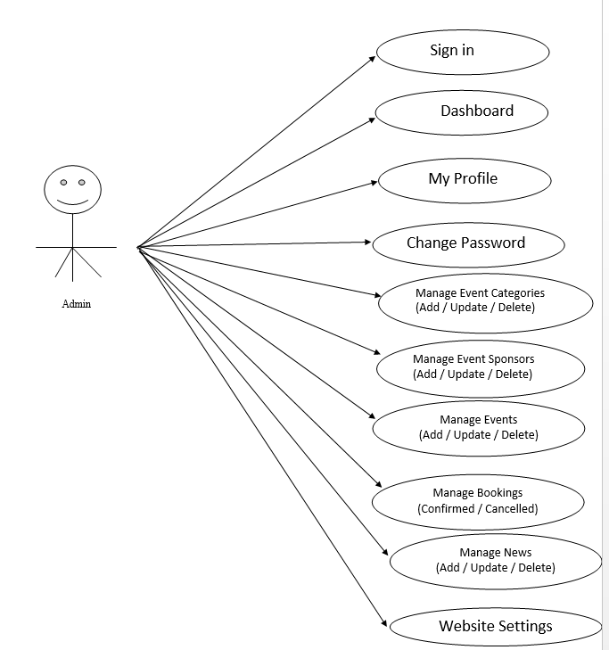
Continue…
Admin use case

Slide 11
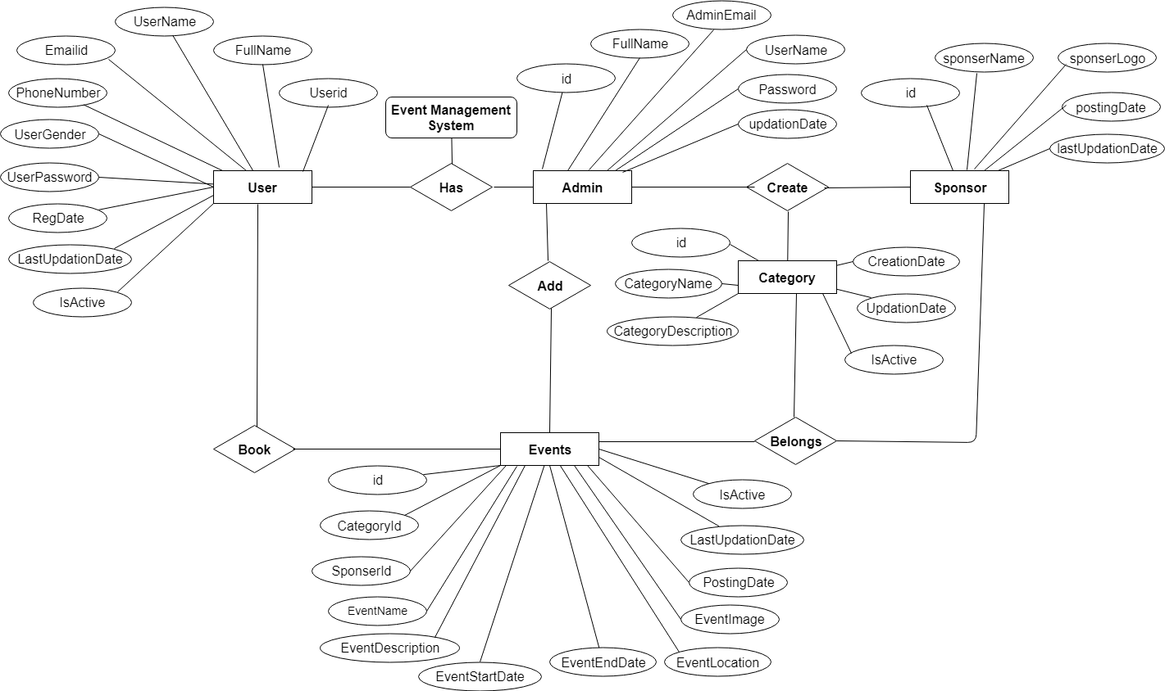
ER Diagram

Slide 12
Dataflow Diagrams (DFDs)
A Data Flow Diagram (DFD) is a traditional visual representation of the information flows within a system. A neat and clear DFD can depict the right amount of the system requirement graphically. It can be manual, automated, or a combination of both.
It shows how data enters and leaves the system, what changes the information, and where data is stored.
The objective of a DFD is to show the scope and boundaries of a system as a whole. It may be used as a communication tool between a system analyst and any person who plays a part in the order that acts as a starting point for redesigning a system. The DFD is also called as a data flow graph or bubble chart.

Slide 13
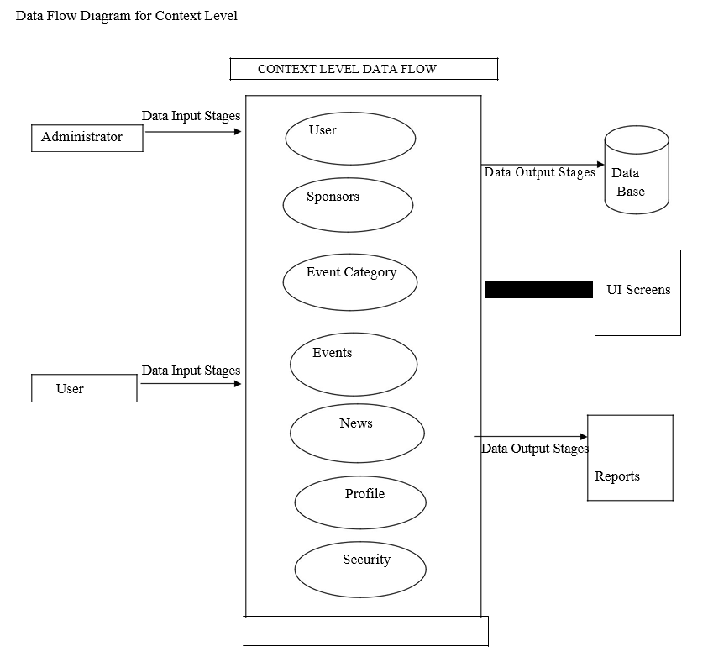

Slide 14
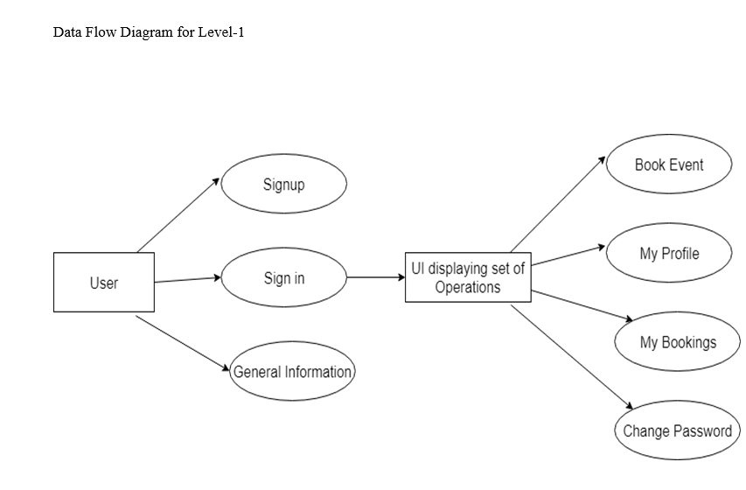

Slide 15
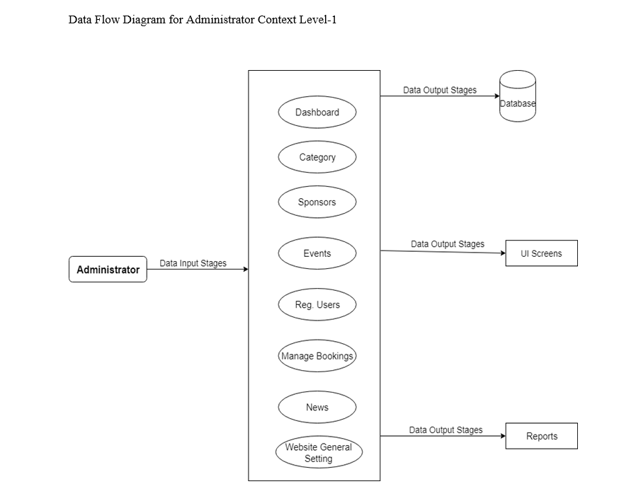

Slide 16
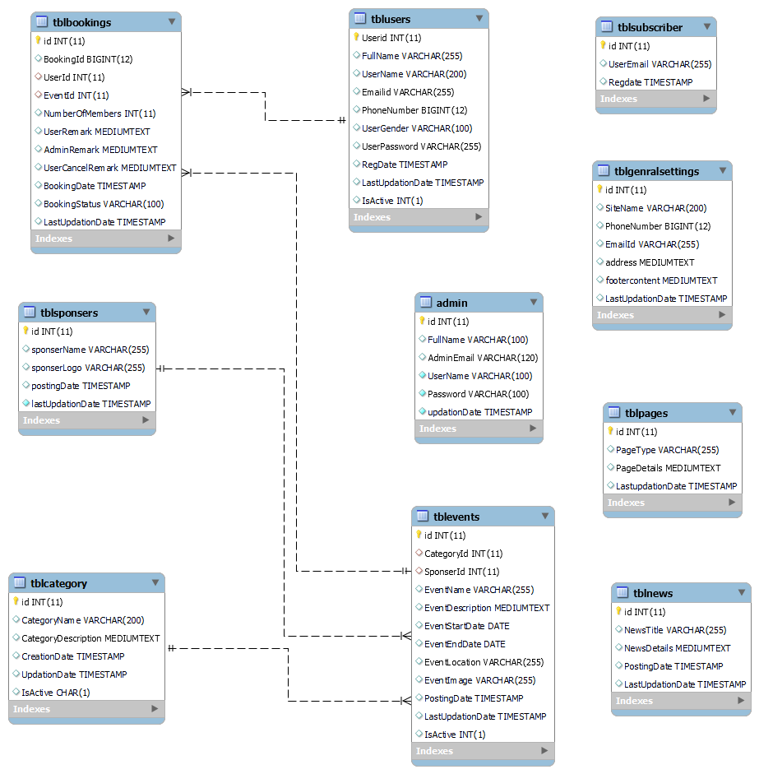
Class Diagram
Notes:
The class diagram shows a set of classes, interfaces, collaborations and their relationships.

Slide 17
Implementation and System Testing
After all phase have been perfectly done, the system will be implemented to the server and the system can be used.
System Testing
The goal of the system testing process was to determine all faults in our project .The program was subjected to a set of test inputs and many explanations were made and based on these explanations it will be decided whether the program behaves as expected or not. Our Project went through two levels of testing
Unit testing
Integration testing

Slide 18
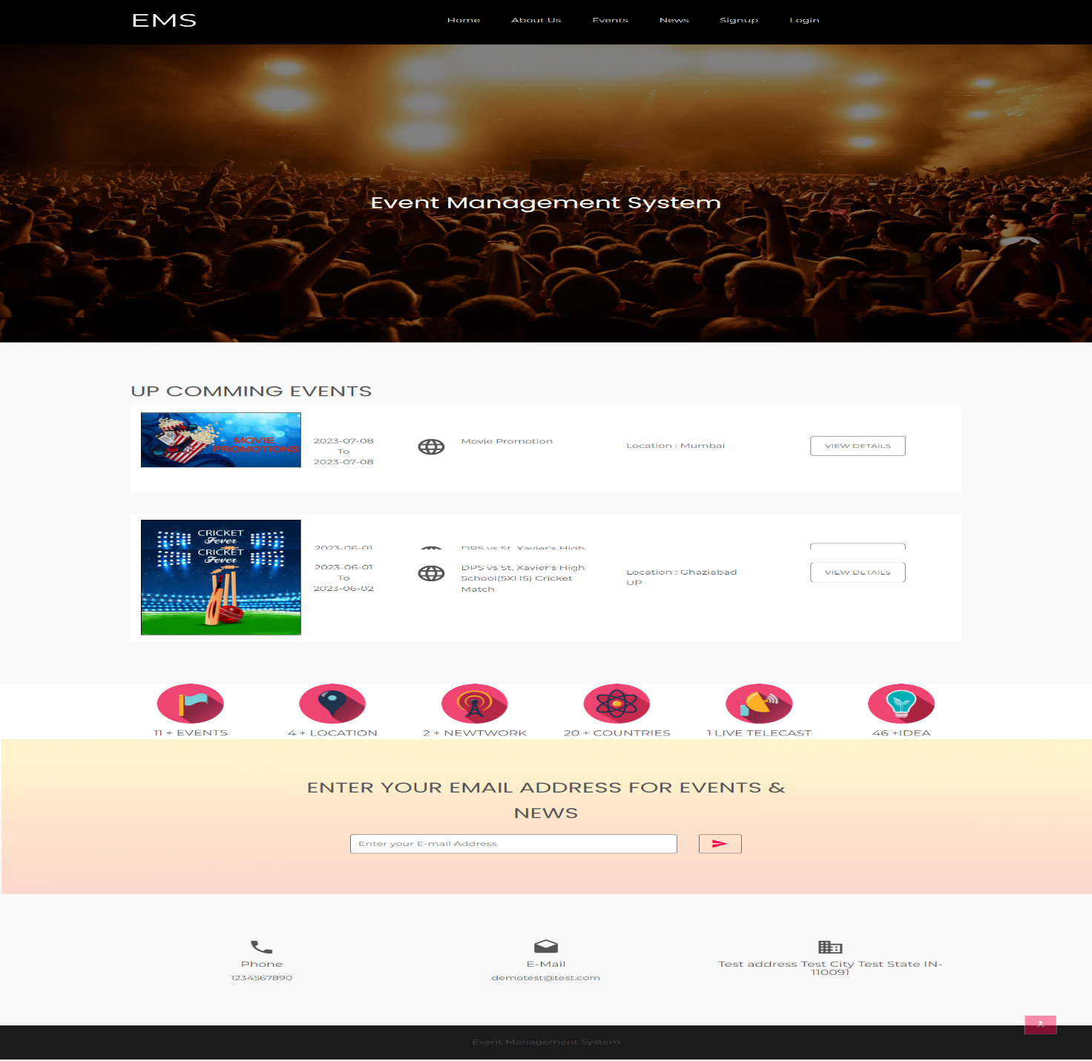
Project Screens

Slide 19
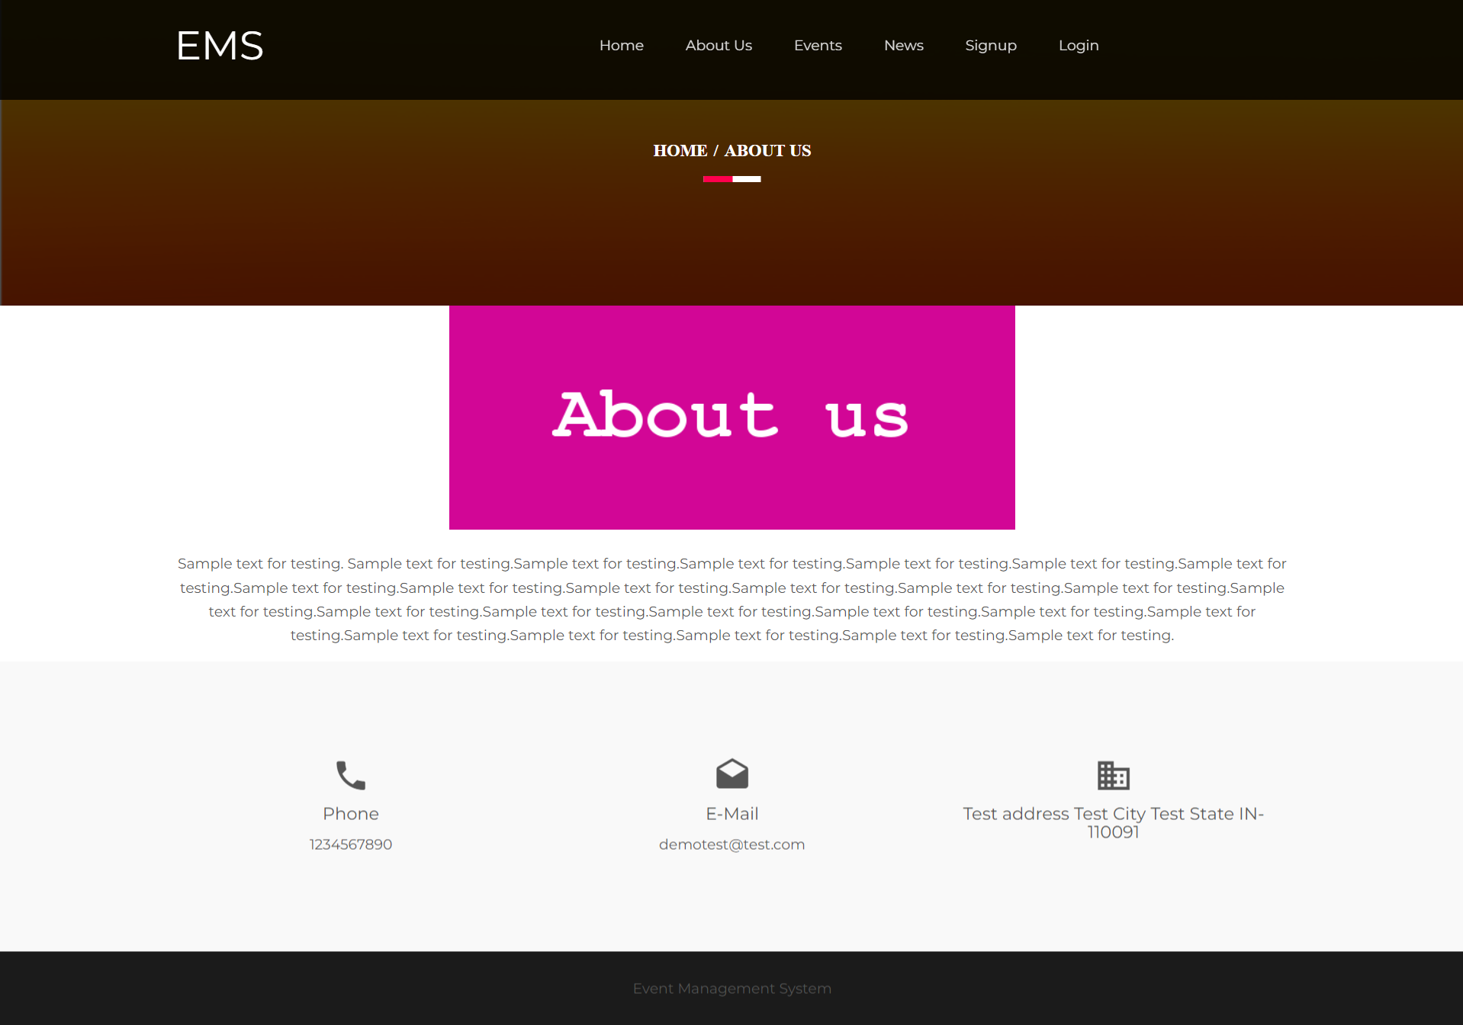
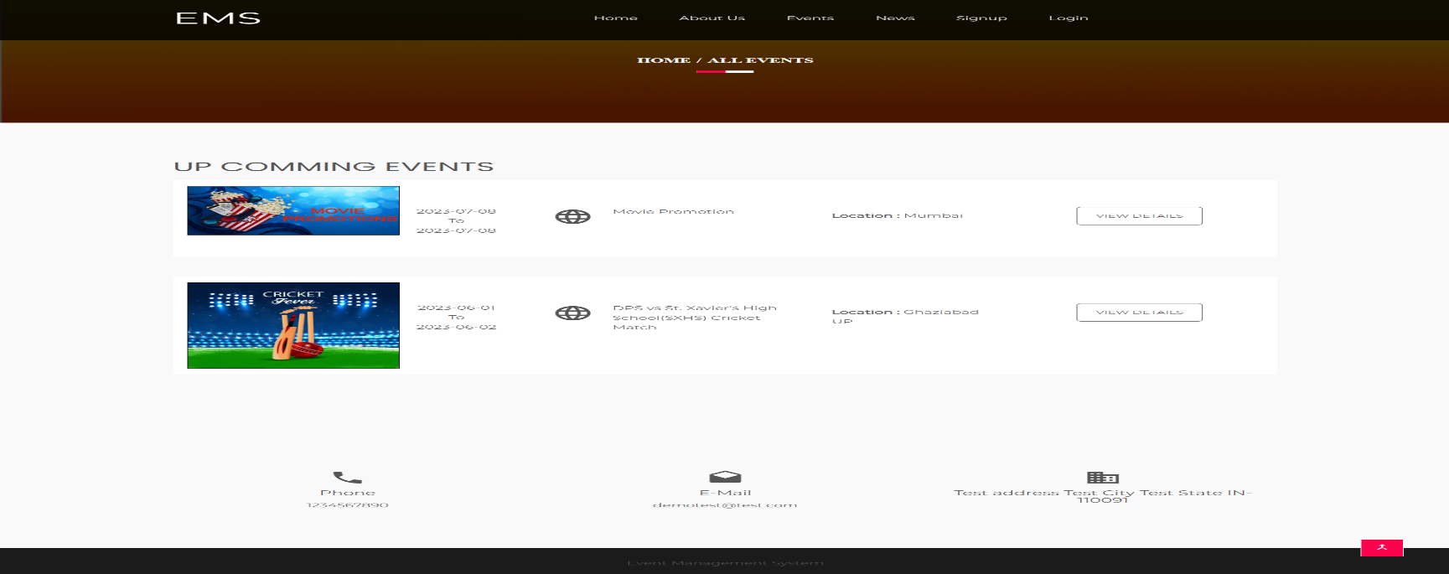

Slide 20
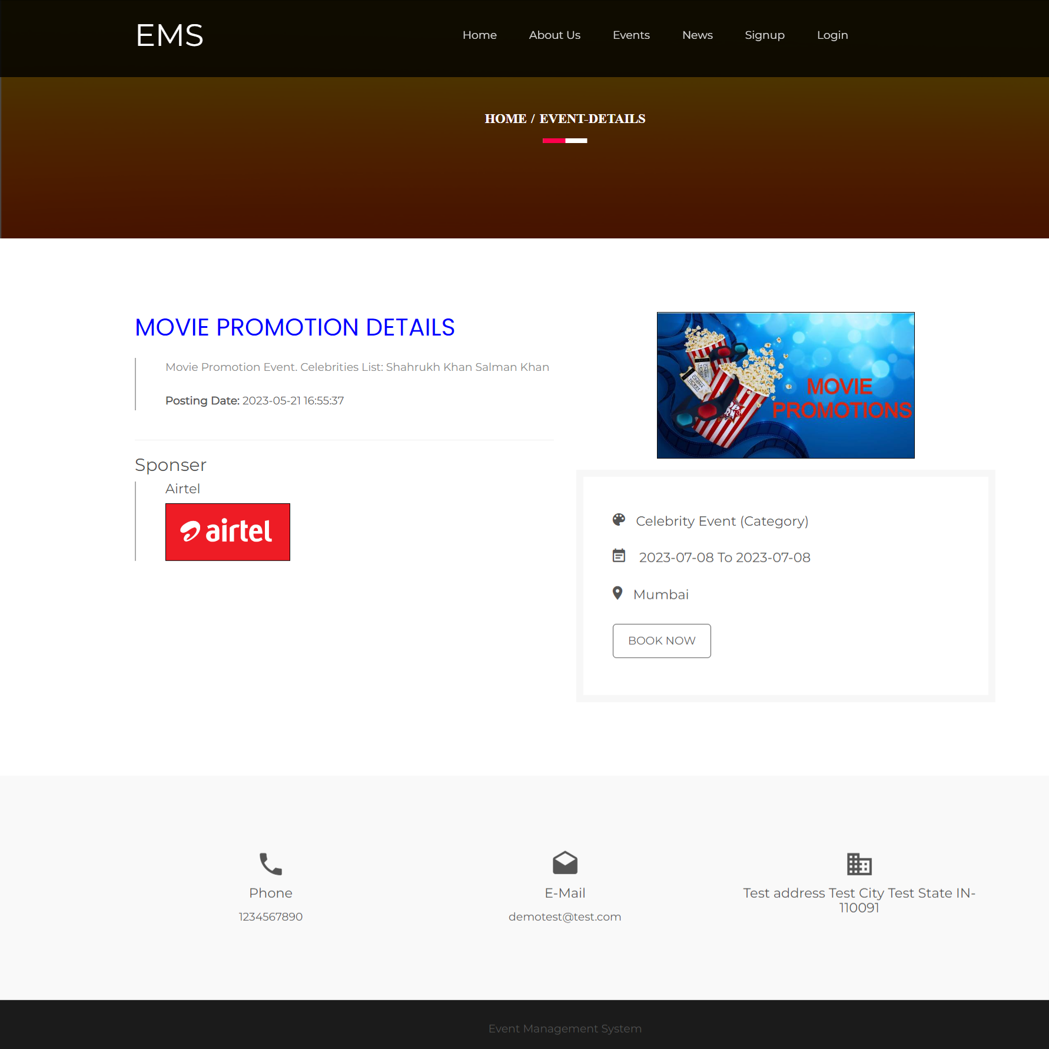

Slide 21
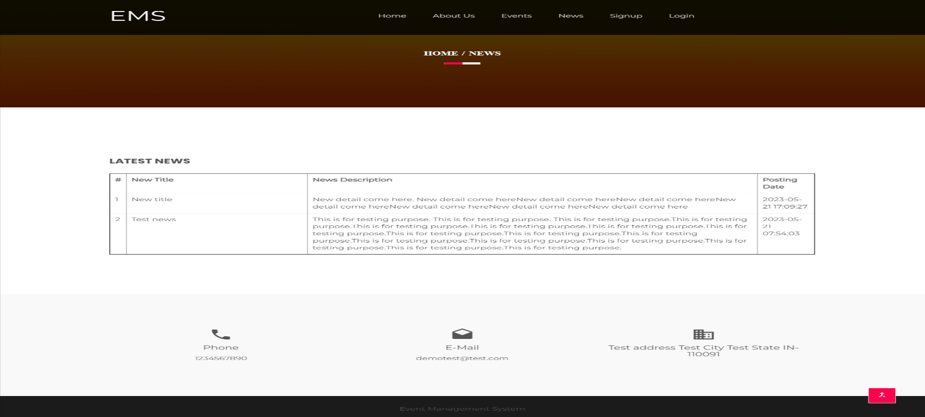
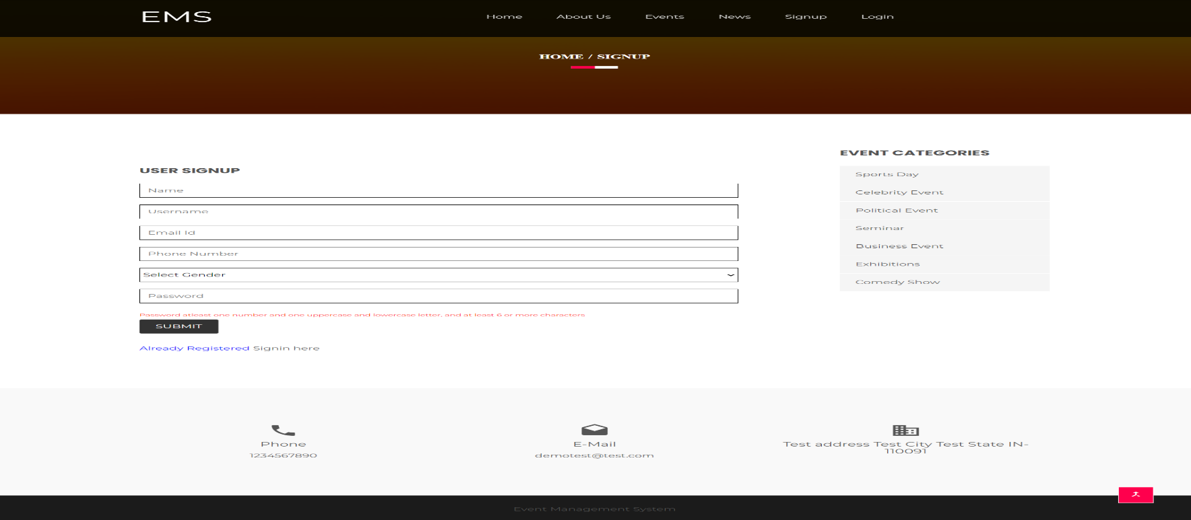

Slide 22
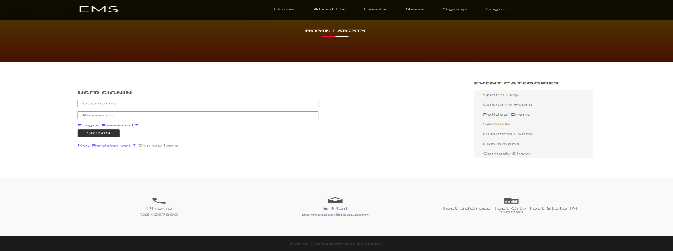
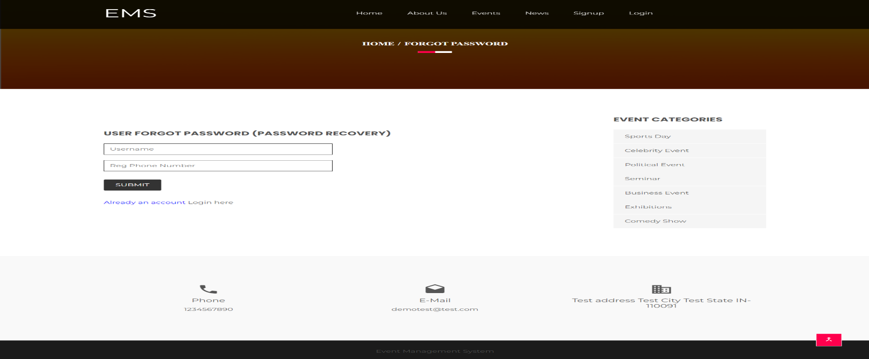

Slide 23
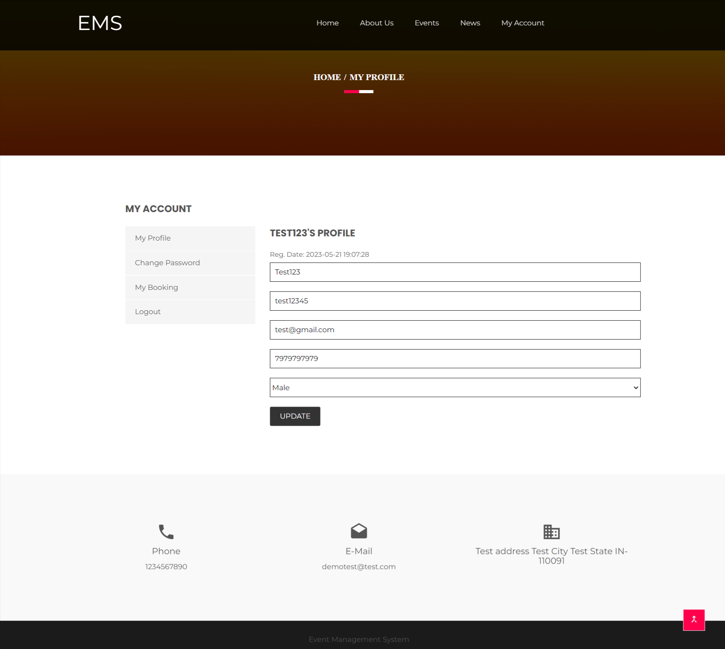

Slide 24
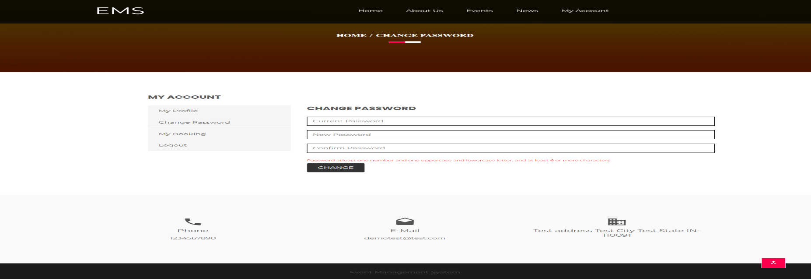
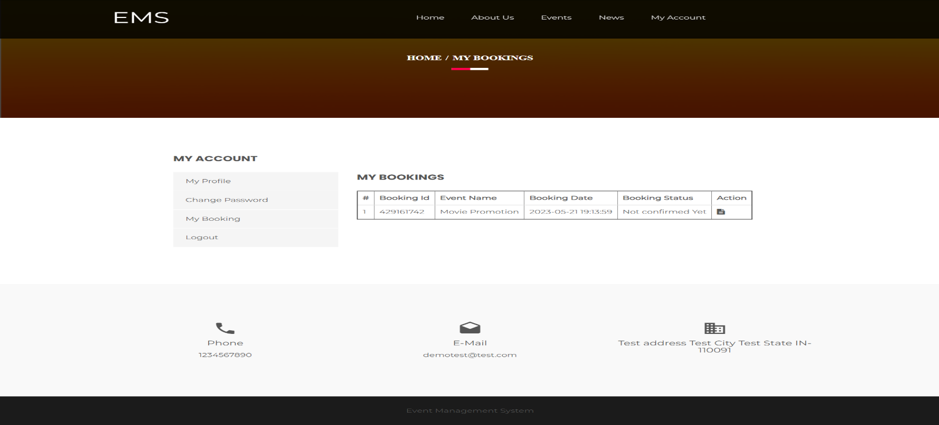

Slide 25
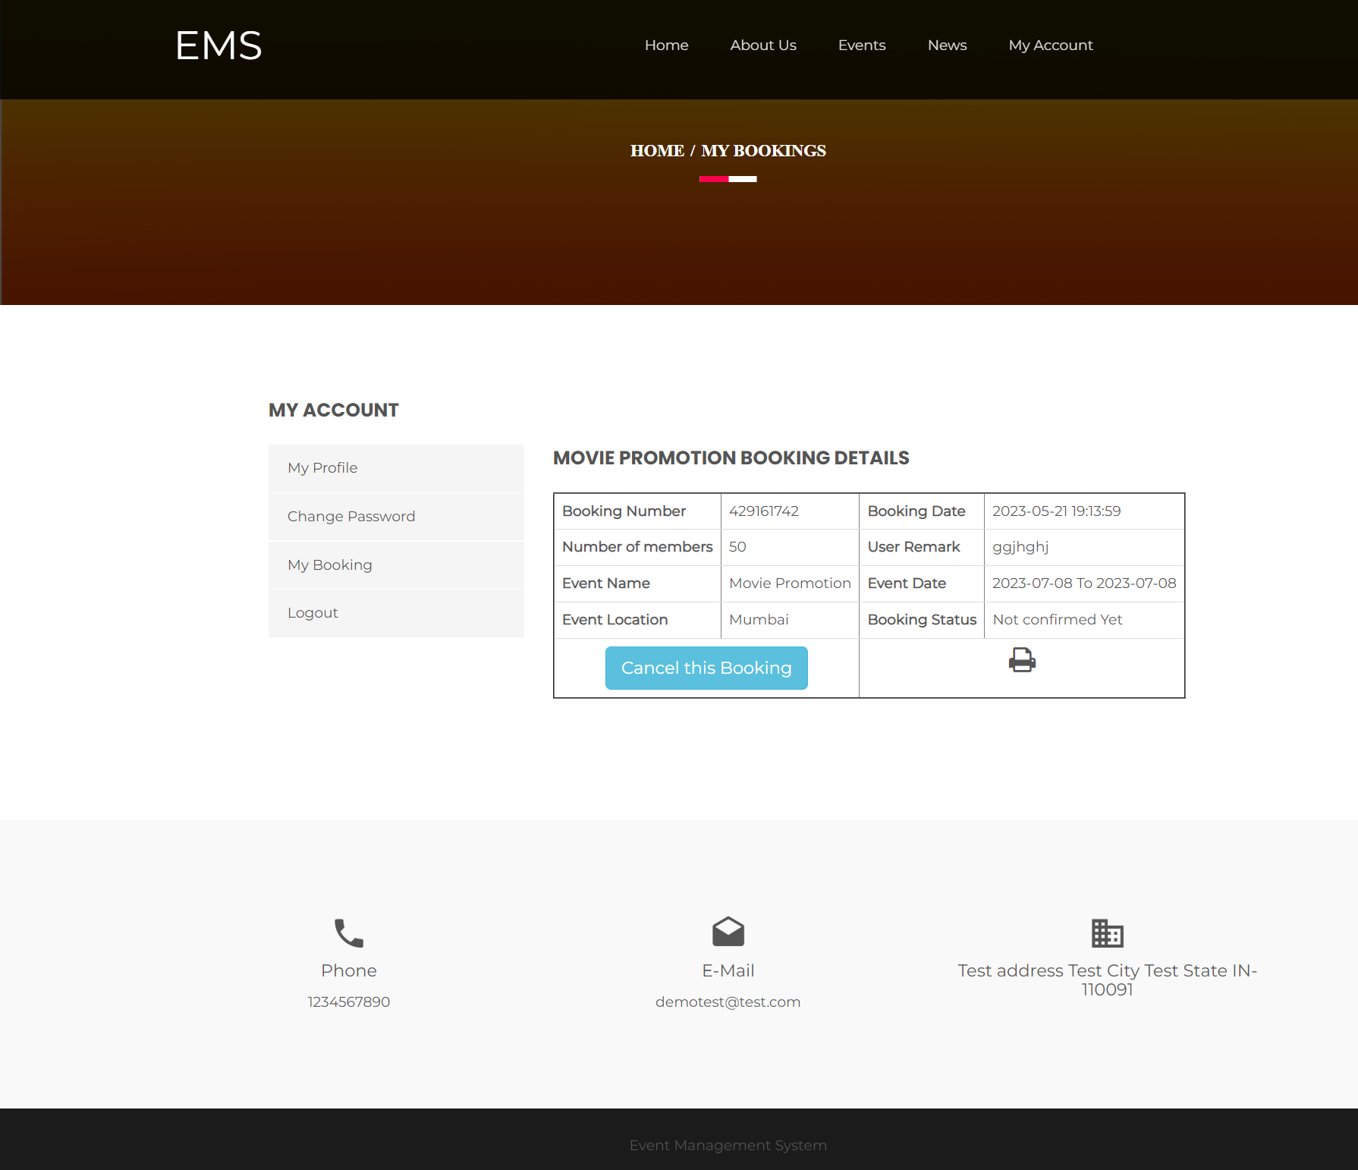
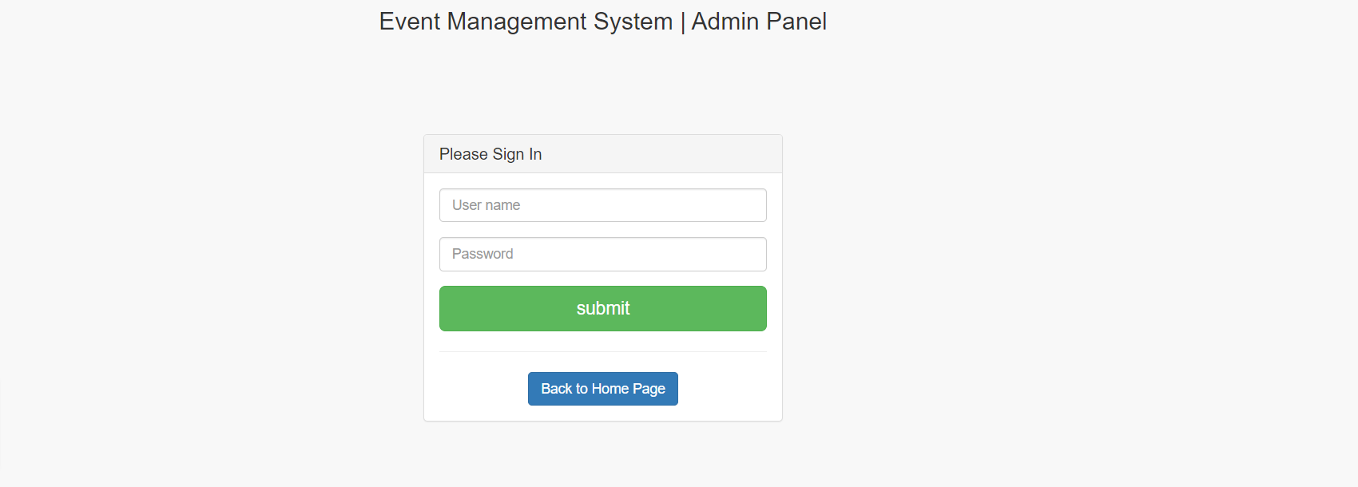

Slide 26
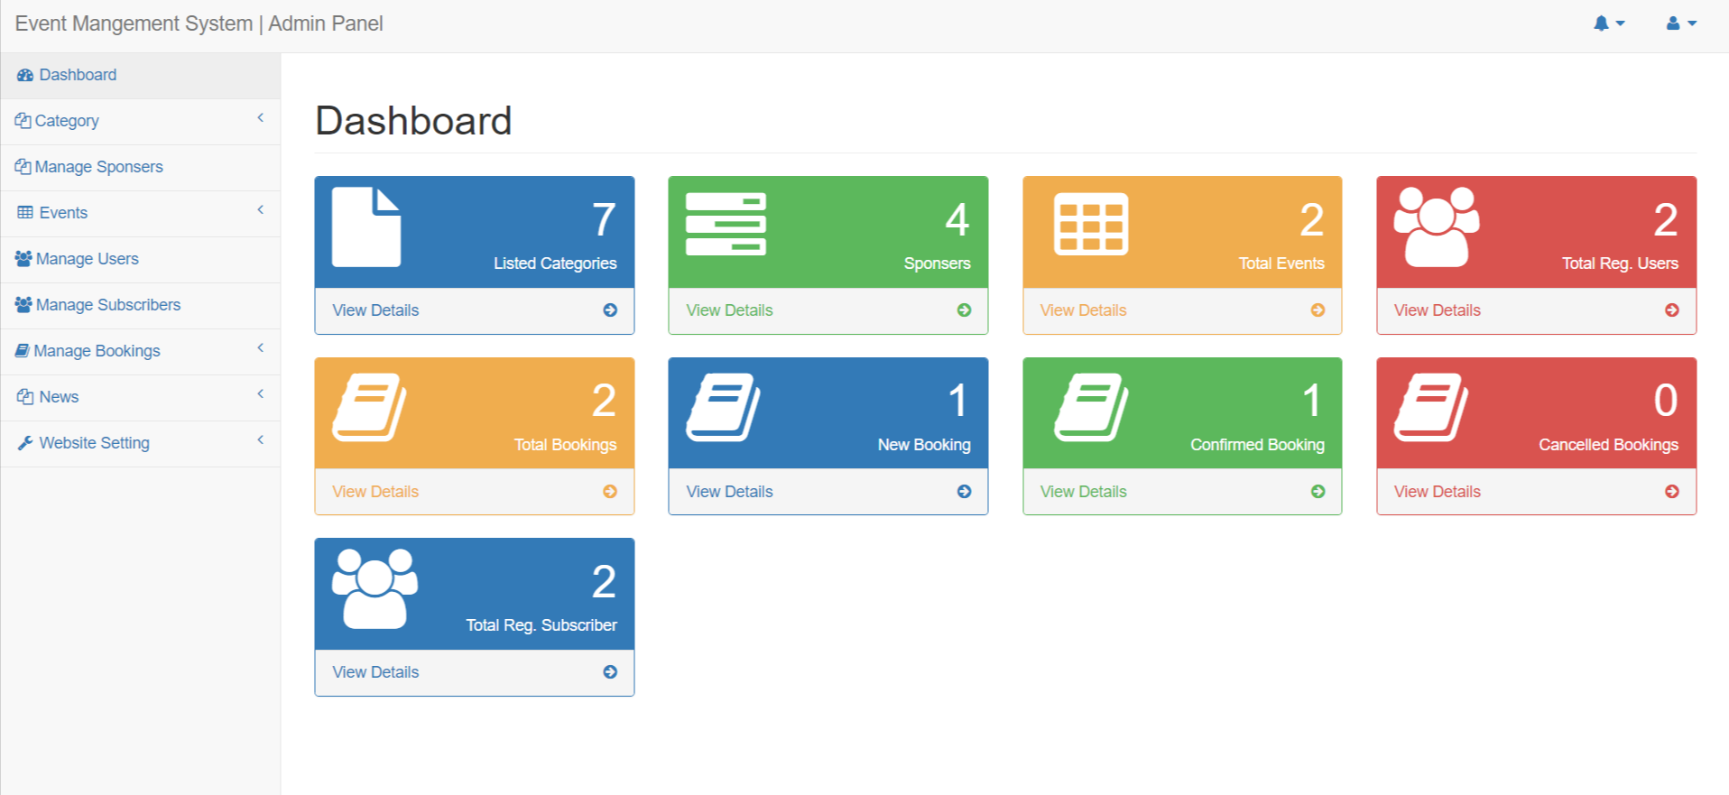
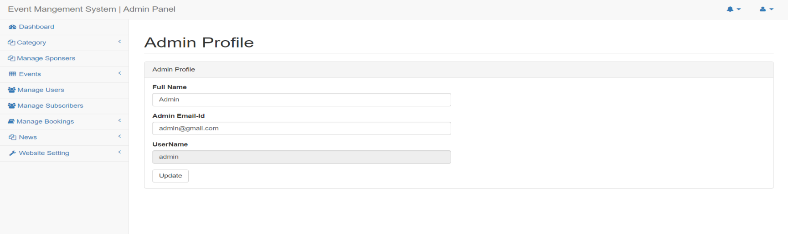

Slide 27
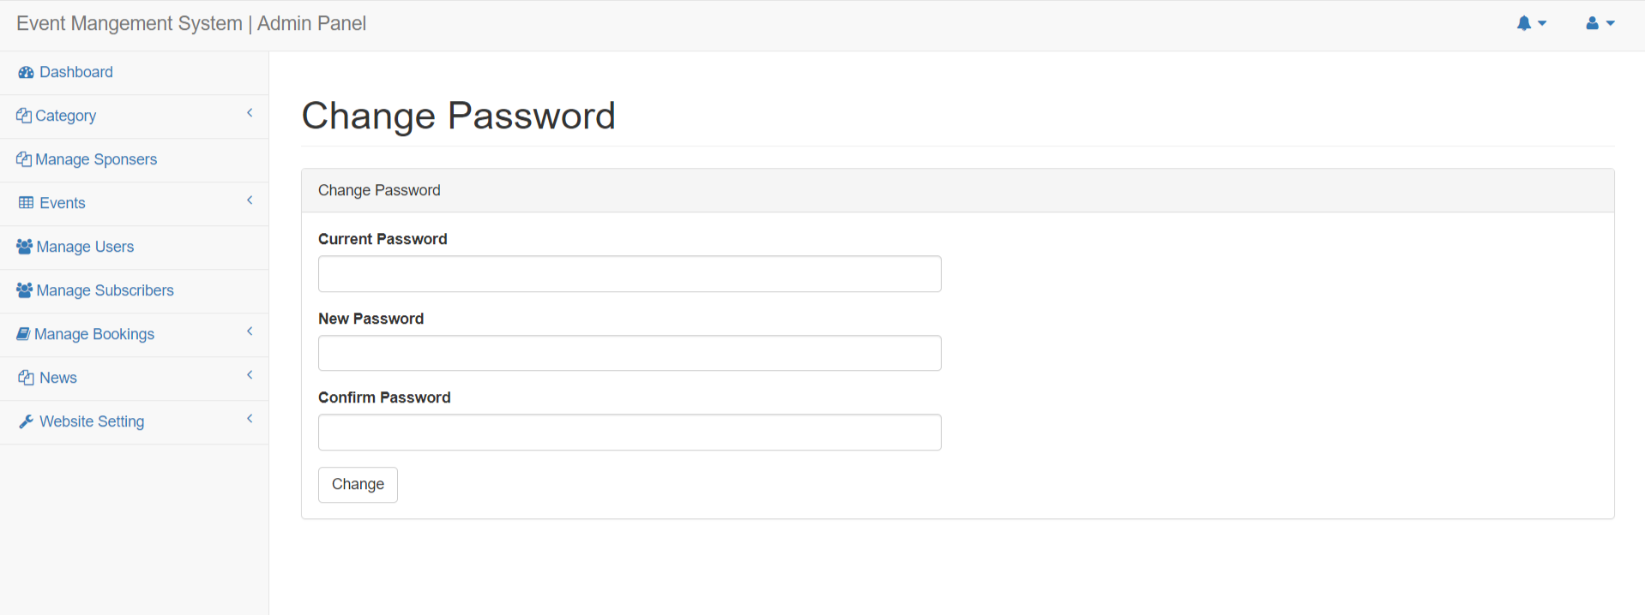
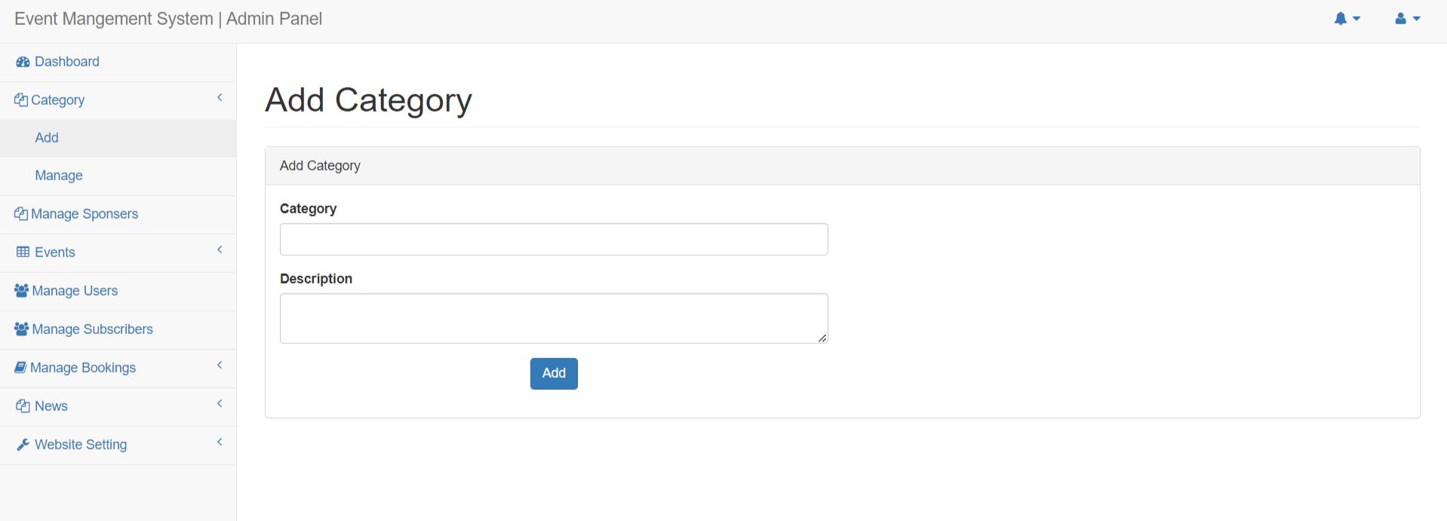

Slide 28
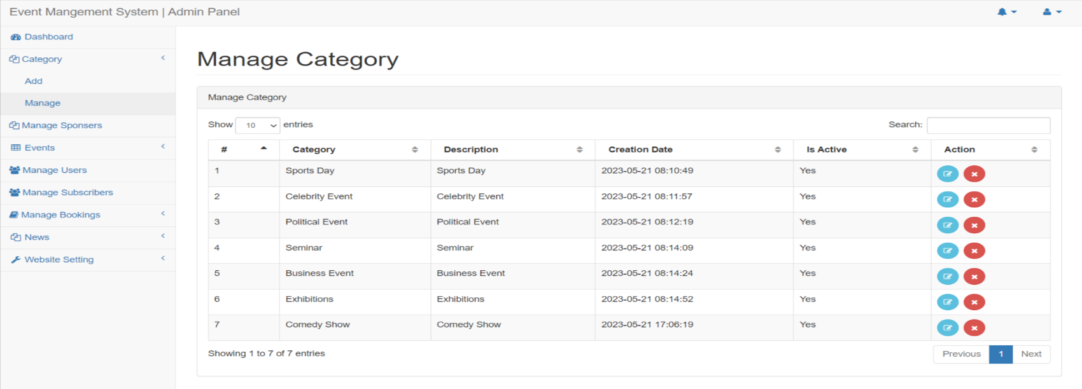
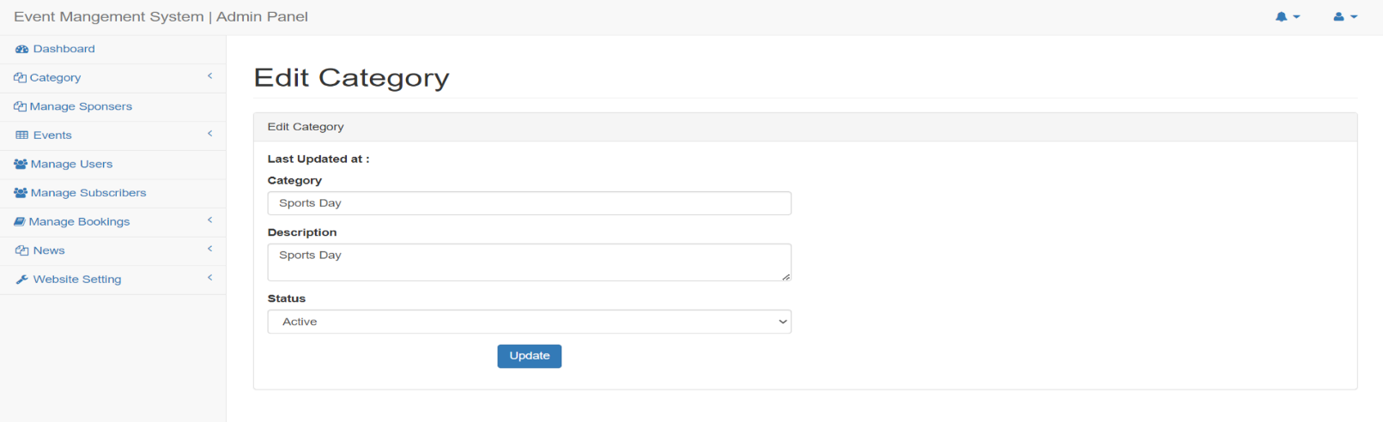

Slide 29
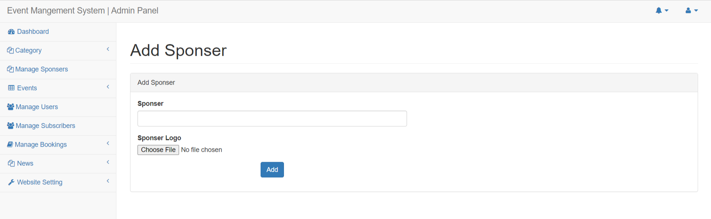
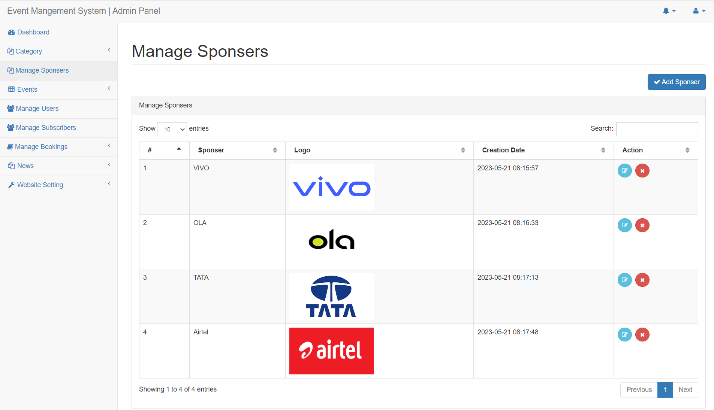

Slide 30
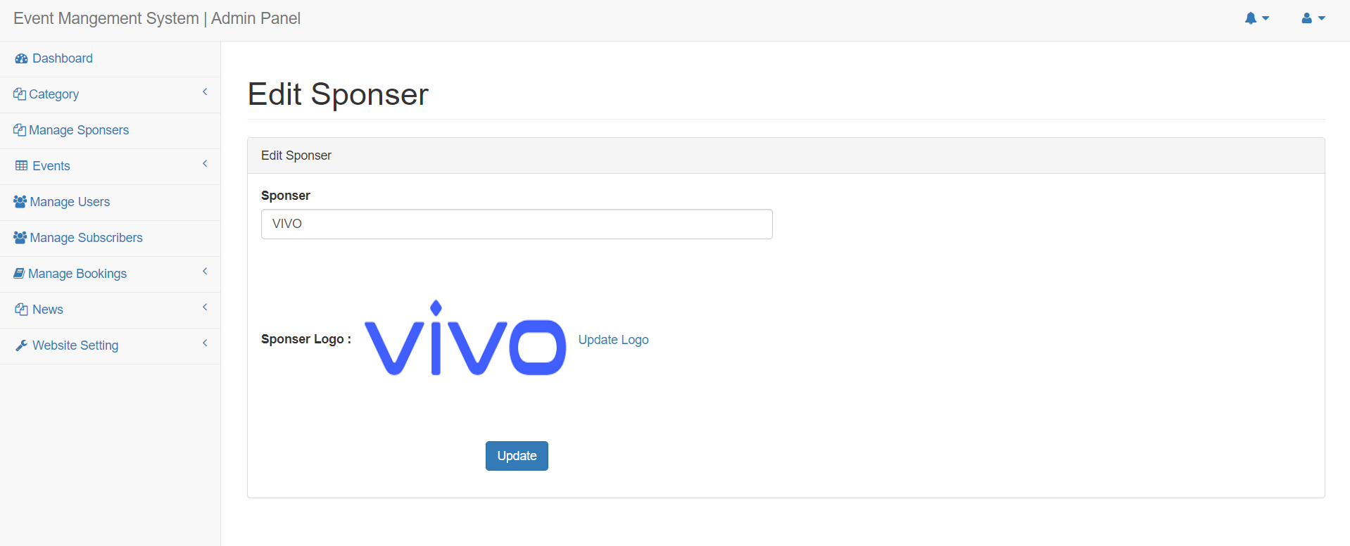
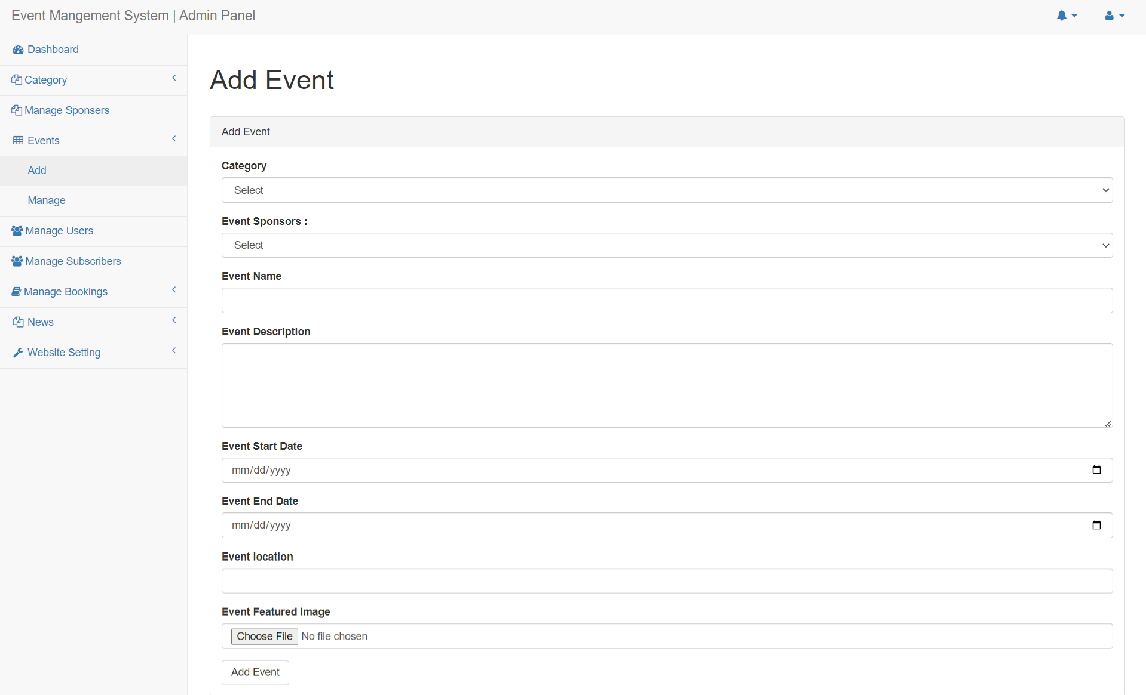

Slide 31
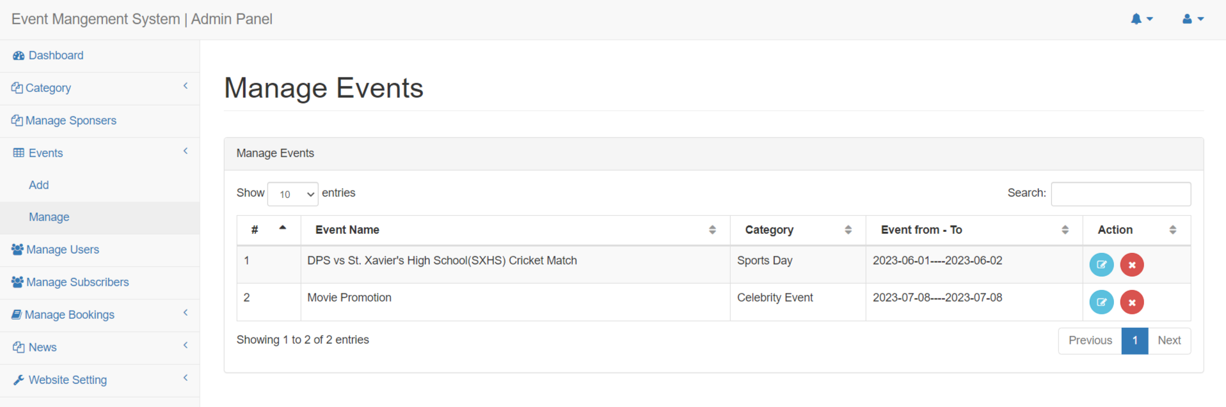
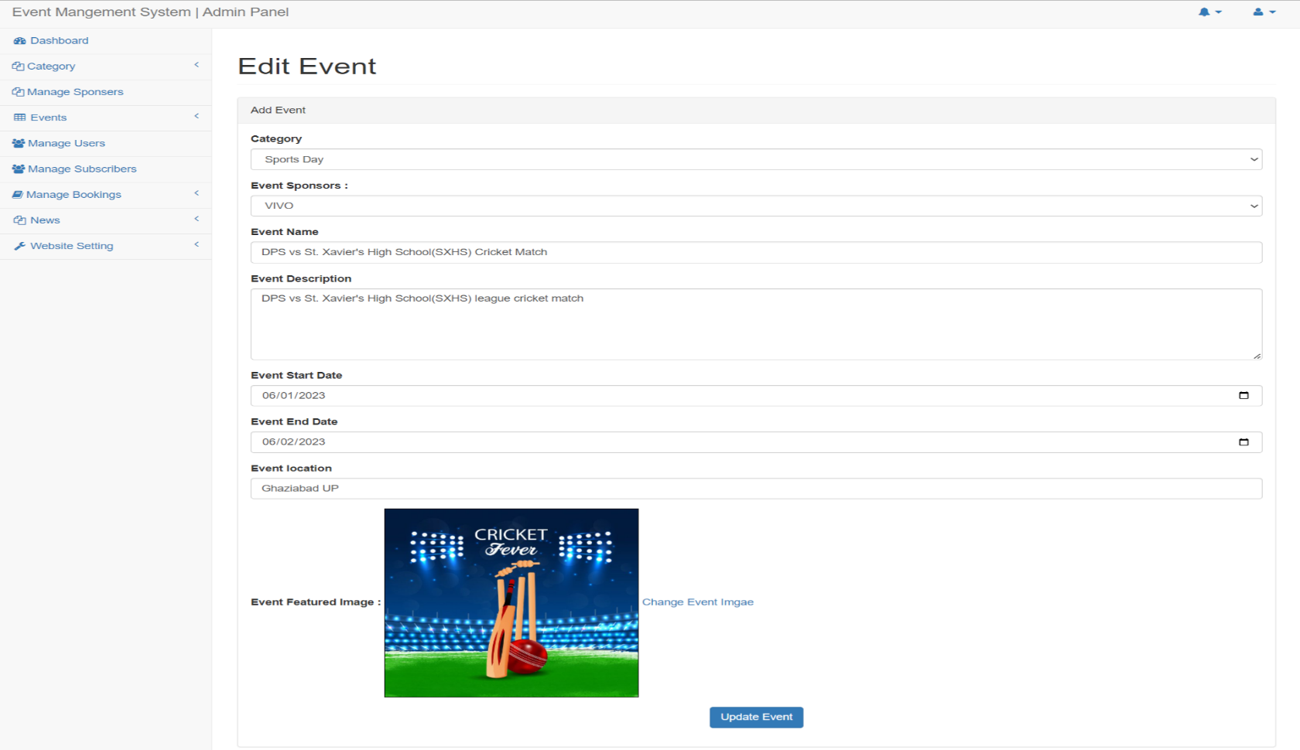

Slide 32
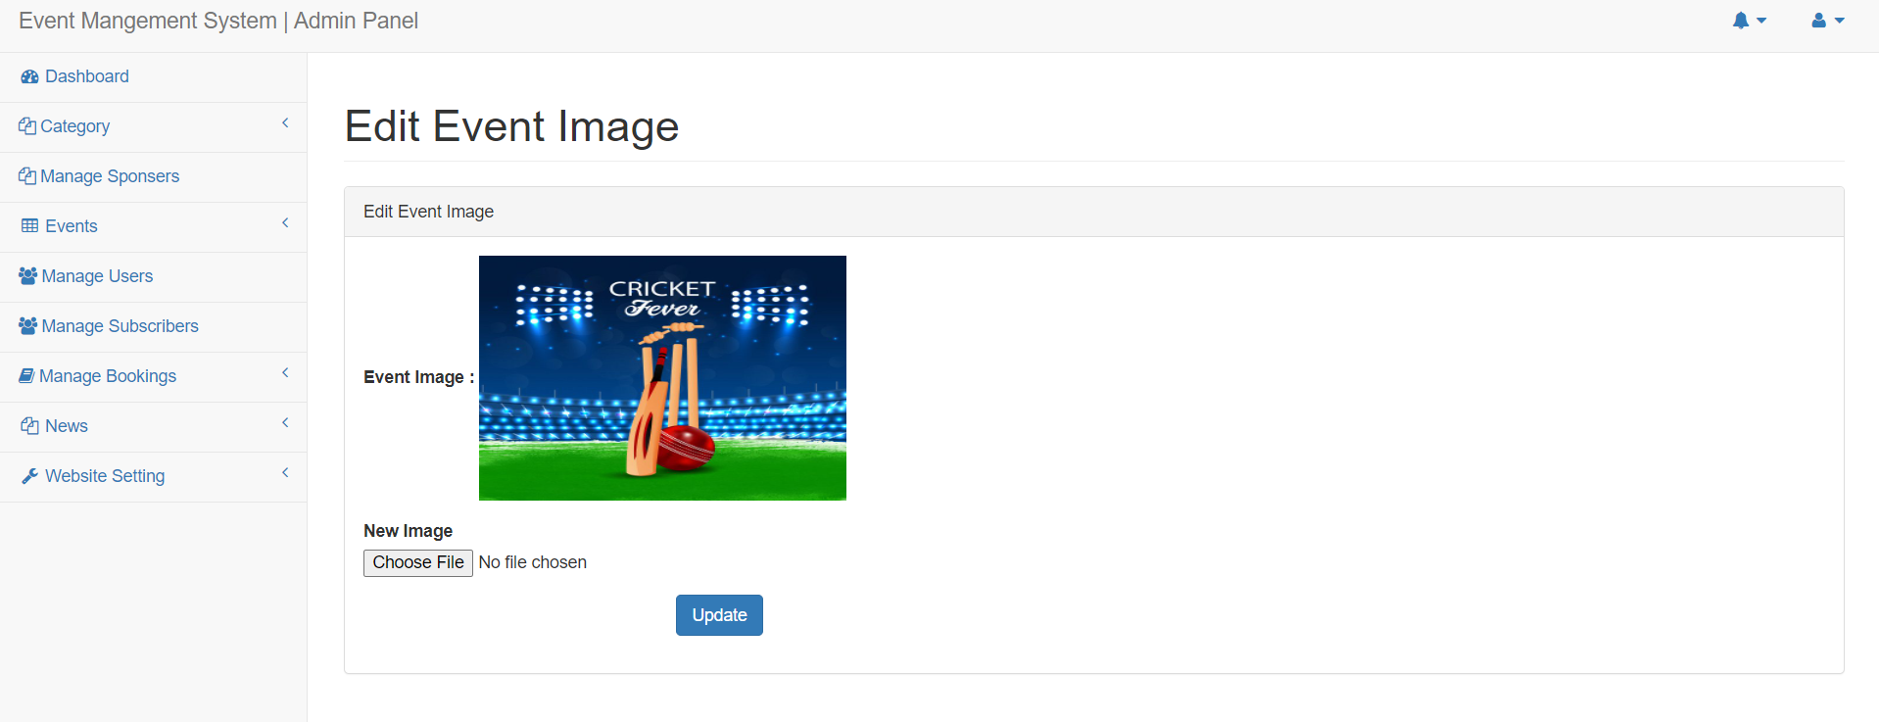
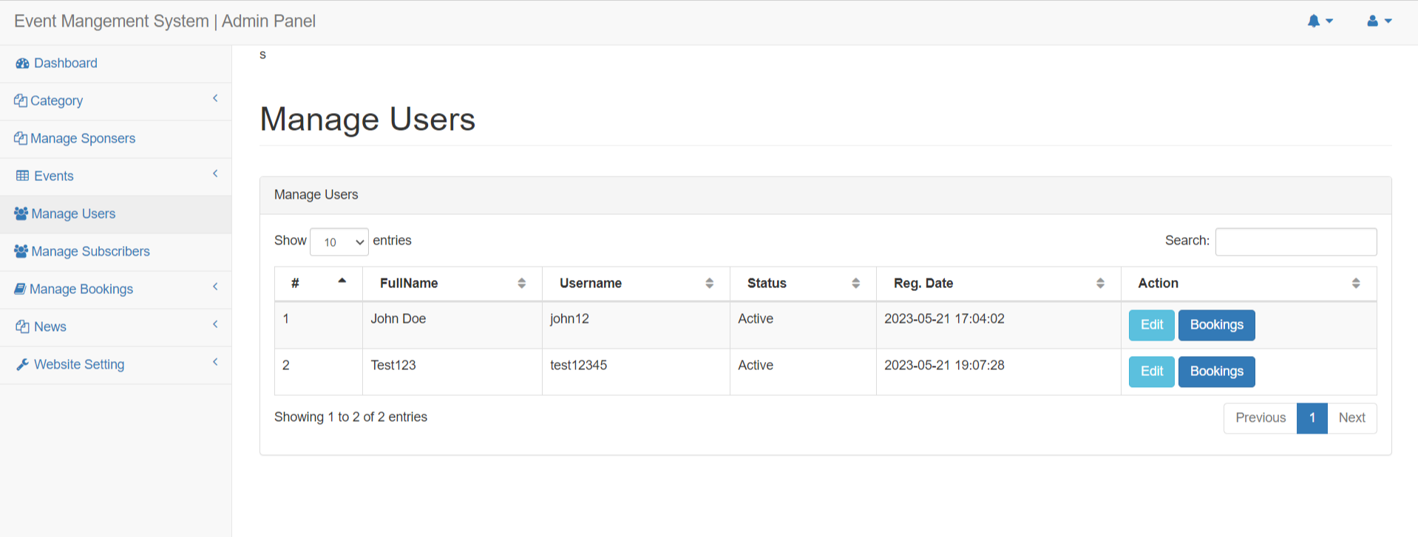

Slide 33
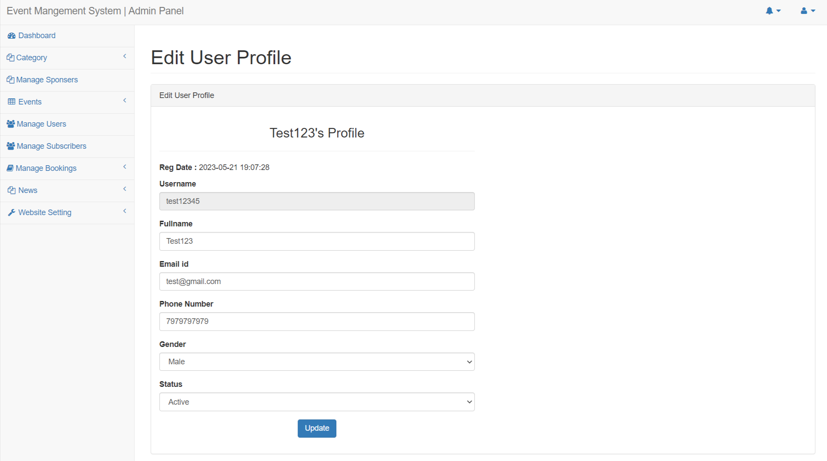
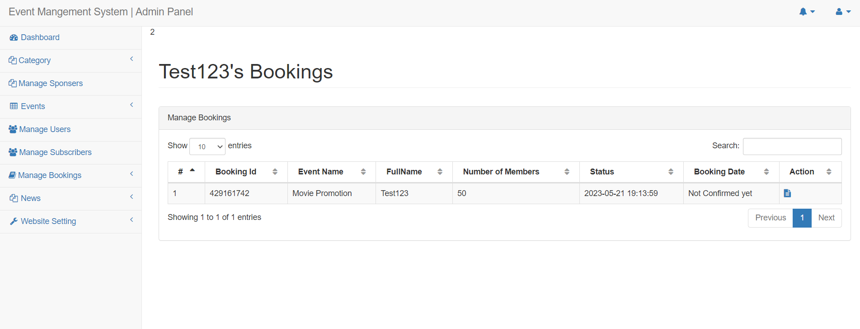

Slide 34
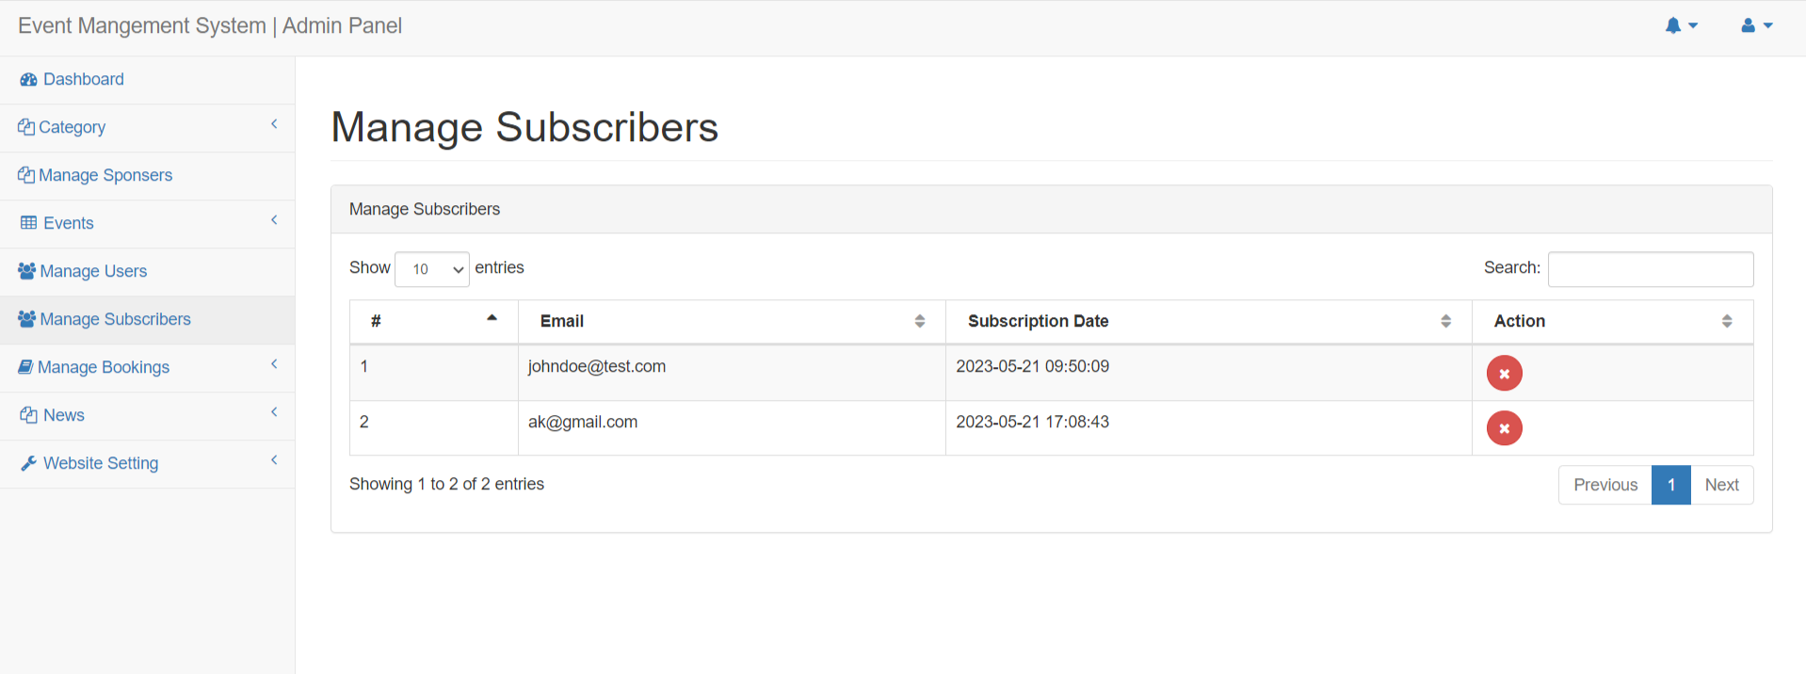
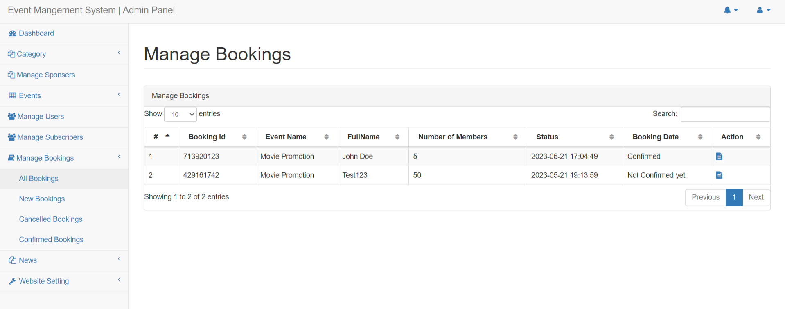

Slide 35
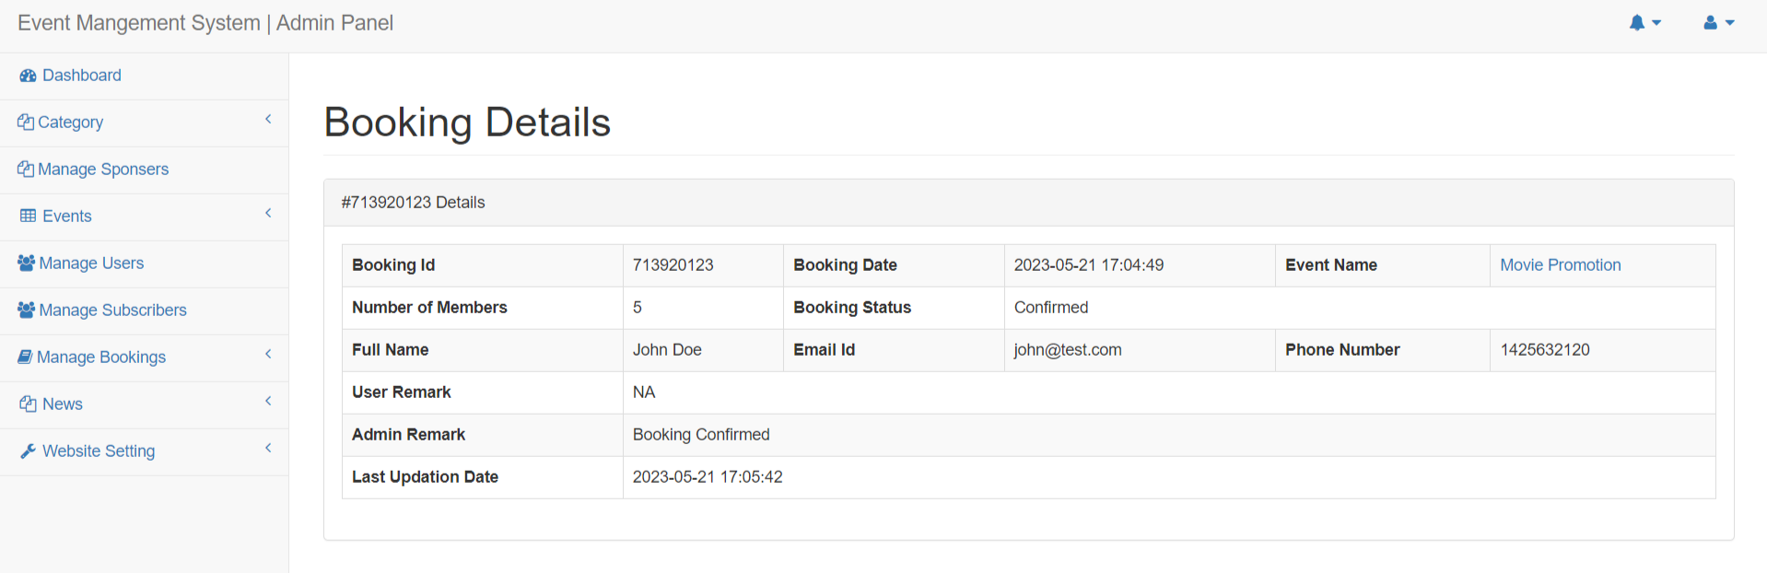
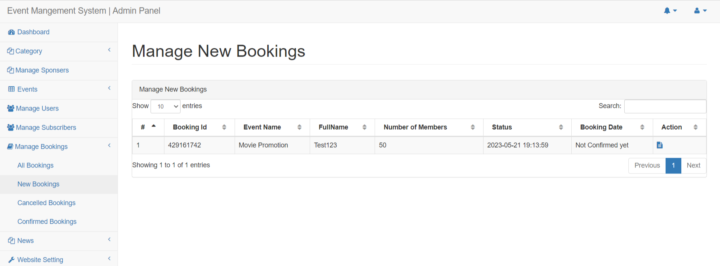

Slide 36
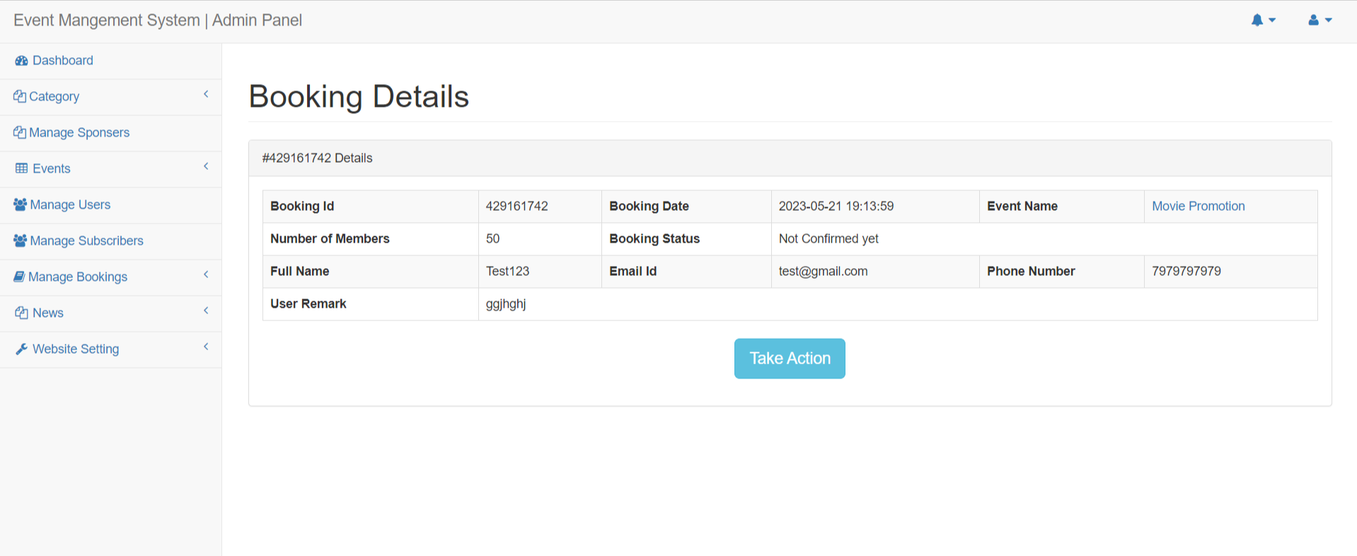
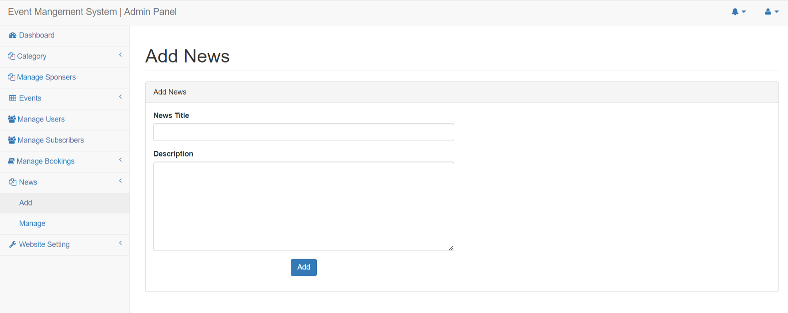

Slide 37
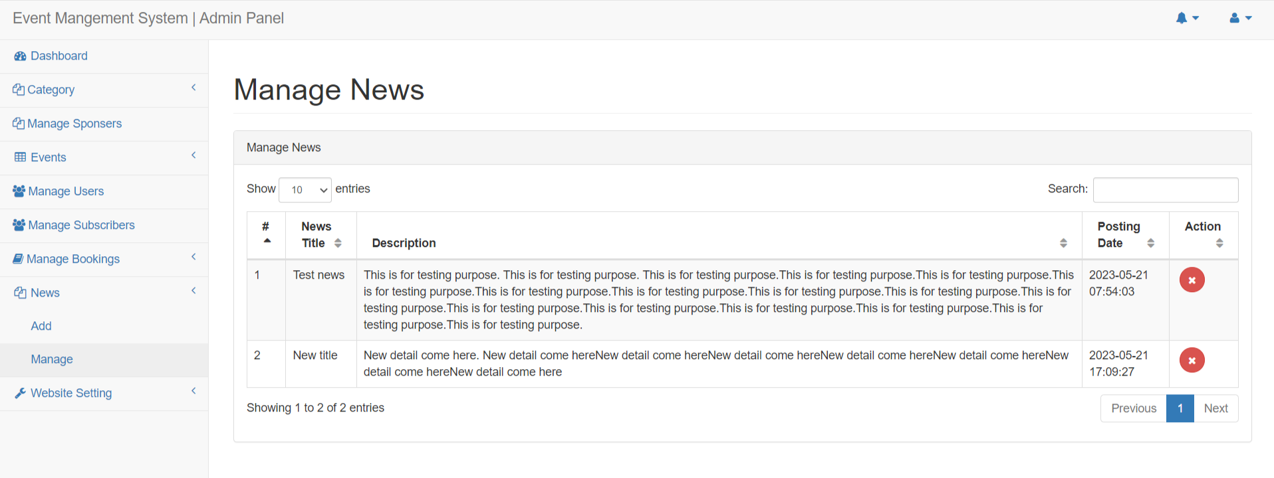
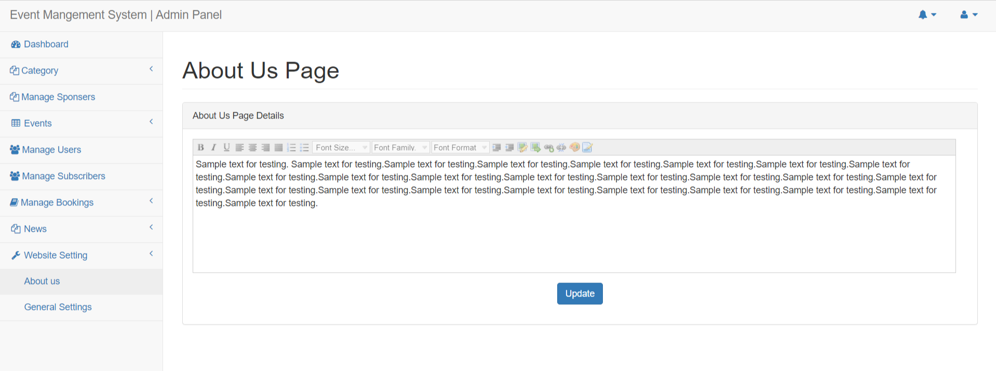

Slide 38
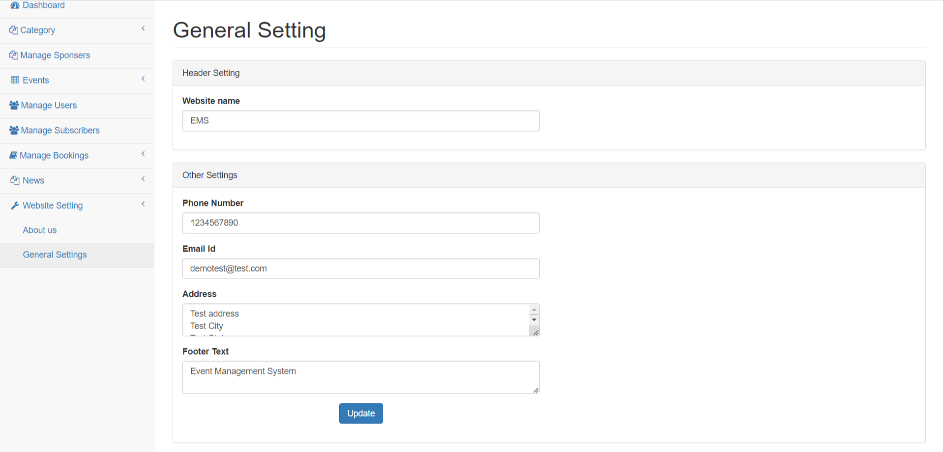

Slide 39
Conclusion
The “Event Management System” was successfully designed and is tested for accuracy and quality. During this project we have accomplished all the objectives and this project Meets the needs of the organization. The developed will be used in searching, retrieving And generating information for the concerned requests.
GOALS ACHIVIED
Reduced entry work
Easy retrieval of information
Reduced errors due to human intervention
User friendly screens to enter the data
Portable and flexible for further enhancement
Web enabled.
Fast finding of information request

Slide 40
References
www.w3schools.com
php.net
en.wikipedia.org/wiki/PHP
www.hotscripts.com/category/php/
www.apache.org
www.mysql.com/click.php?e=35050

Slide 41
Thank You

